Slide 1

Tablet Launch Evaluation Findings

Slide 2
Summary
Our mission with the test launch was to check the ease-of-use of the tablets and customers’ satisfaction using them. We conducted a survey for the 50 customers that participated. For the test launch, we asked the customers to engage with the newly implemented tablets, as if they were participating in a typical restaurant experience. The customers were sent a digital survey after their experience ended.

Slide 3
Overview
In our test run, our team’s goal was to measure several quality standards criteria surrounding customer satisfaction. We aimed to understand if it was easy for customers to order from the tablets, and how did they feel with the overall experience. These are our findings:

Slide 4
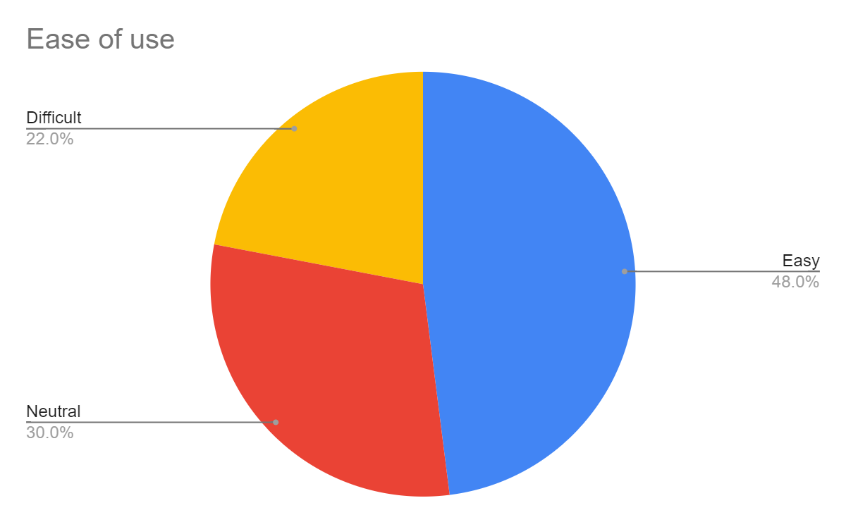
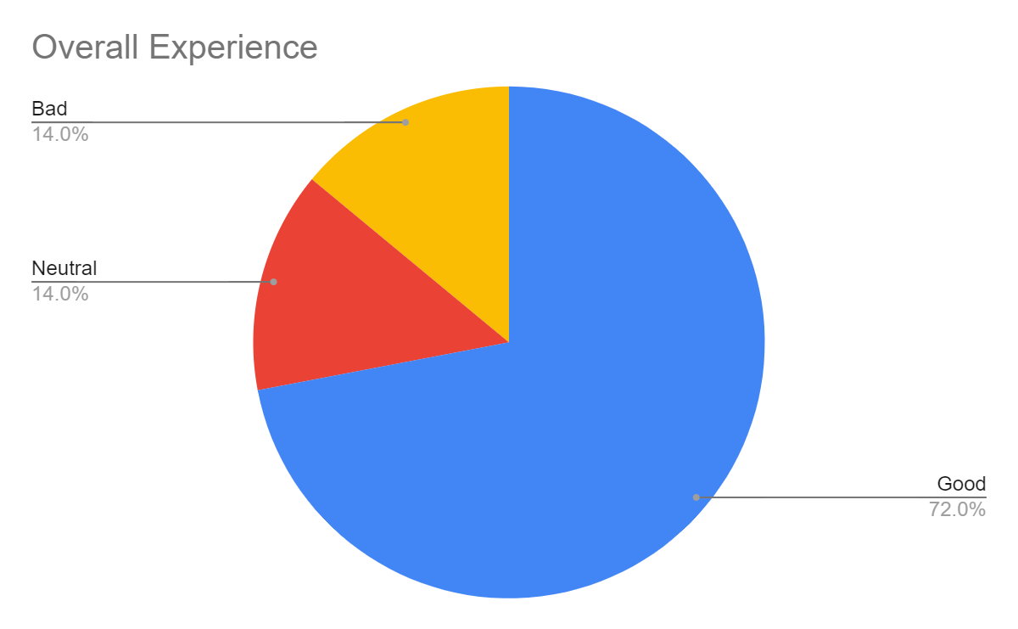
Findings

Slide 5
Next Steps
As the findings show, our overall user experience shows promise, with 86% positive or neutral responses.
The ease of use of the tablets could be improved, with mixed results from the survey.
I would recommend these steps in order to maintain high customer satisfaction rates and improve the tablets’ ease-of-use:

Slide 6
Next Steps
Make a quick guide that the customer will receive when opening the tablet, showing him how to properly use the tablets’ functionality
Have weekly surveys after launch to ensure that customer satisfaction rates remain high

